Slide 1
Predictive Analysis of Life Expectancy
By-
Ananya Devaraju
Jagapthi Raju
Nazeeha
Priyanka Bhagwat
Rathan Narayana Raju
Sagar Gondaliya

Slide 2
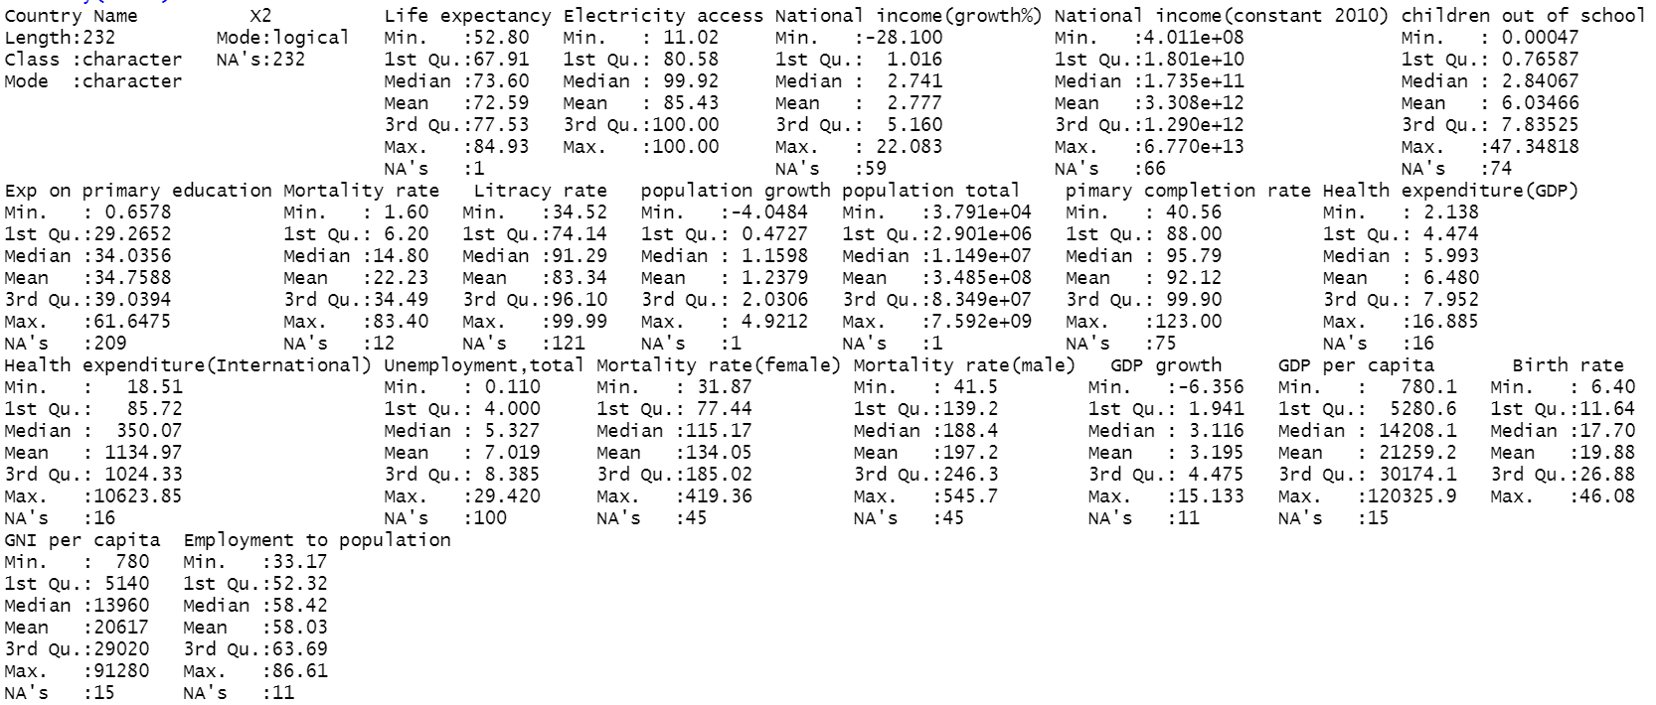
Analyzation of Data using Graphical & Numerical Representations
DESCRIPTIVE STATISTICS:
The data consists of 232 rows and 23 columns. The rows represents the information about 232 countries .
In 23 column variables Life expectancy variable is the response variable and remaining are predictor variables.
As per the mean values of the mortality rate variable, the male(197.2) has higher mortality rate than female (134.05).
Each variable in dataset has NA values.

Slide 3
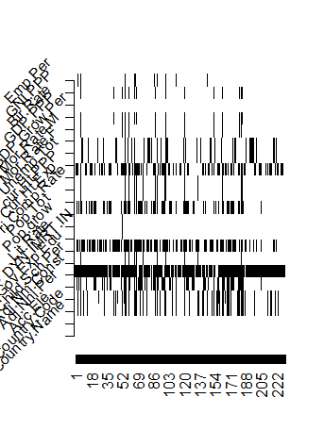
Dealing with Missing Values
893 NA’s out of 5336 values in the dataset
“Gov.Exp.Edu” has 90% NA’s
12 cases with 50% NA’s
1 case with missing response
7 cases without any NA’s
Complete case analysis is not feasible
Single imputation – imputes single value & reduces variability in data

Slide 4
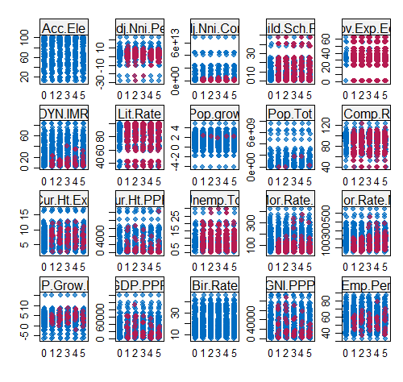
Multiple Imputation
Uses the distribution of observed data to estimate missing values, by imputing m times.
Three stages:
Imputation
Analysis
Pooling :
R^2 = 0.959

Slide 5
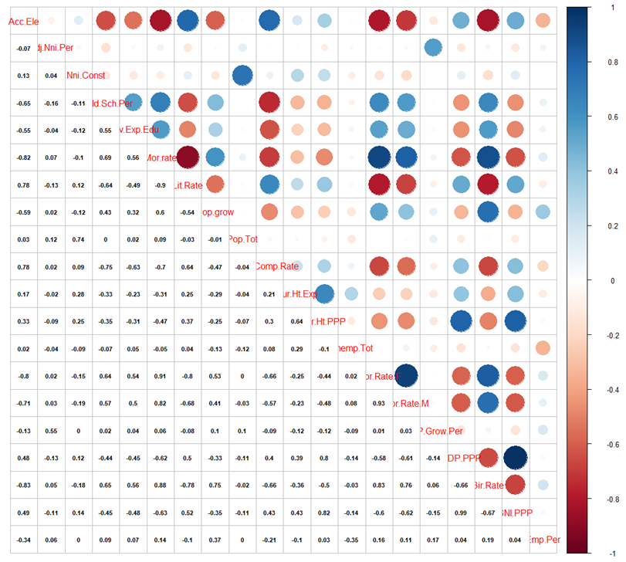
Collinearity
(Multi)collinearity can be identified using variance inflation factor (VIF)
Values of VIF that exceed 10 are often regarded as indicating multicollinearity.
Multi-collinearity is eliminated using step-by-step variable selection.

Slide 6
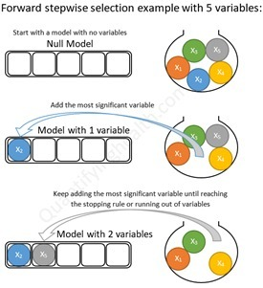
Feature Selection
Wrapper Method
Forward ,backward and stepwise
We use stepwise
step() in R
Uses A.I.C as measuring criteria
Akaike information criteria
Returns the best model with the lowest A.I.C
Model :
glm(formula = Life.exp ~ Adj.Nni.Per + Mor.rate + Pop.grow + Pri.Comp.Rate + Cur.Ht.Exp + cur.Ht.PPP + Mor.Rate.F + Mor.Rate.M + GDP.PPP + Bir.Rate + GNI.PPP)
A.I.C = 859.2

Slide 7
Evaluation of the model
Variable | p-value | Variable | p-value
(Intercept) | < 2e-16 | cur.HT.PPP | 0.000218
Adj.Nni.Per | 0.009601 | Mor.Rate.F | 6.76e-08
Mor.rate | 3.98e-09 | Mor.Rate.M | 0.001125
Pop.Grow | 0.005724 | GDP.PPP | 0.008288
Pri.Comp.Rate | 0.100029 | Bir.Rate | 2.30e-06
Cur.Ht.Exp | 0.030901 | GNI.PPP | 0.016652

Slide 8
Prediction using test data
Cleaning done using same procedures
Challenges High collinearity between four variables GNI.PPP, Pri.Comp.Rate , Lit.Rate and Gov.Exp.Edu
Dropped from dataset
Redefined new model
After checking p-values , dropped GNI.PPP and Pri.Comp.Rate
New MODEL :
glm(formula = Life.exp ~ Adj.Nni.Per + Mor.rate + Pop.grow + Cur.Ht.Exp + cur.Ht.PPP + Mor.Rate.F + Mor.Rate.M + GDP.PPP + Bir.Rate)

Slide 9
Predictions
Cote d'Ivoire | 56.2903580324606
Estonia | 67.4727106824908
Gambia, The | 62.7109298452205
Iran, Islamic Rep. | 77.3303422742446
Jordan | 74.7929235714998
Macao SAR, China | 80.599031251284
Nepal | 71.3409271672365
Papua New Guinea | 66.1300006268544
Somalia | 56.5054072757901
West Bank and Gaza | 73.3589297164777
Zimbabwe | 58.6794011935106

Slide 10
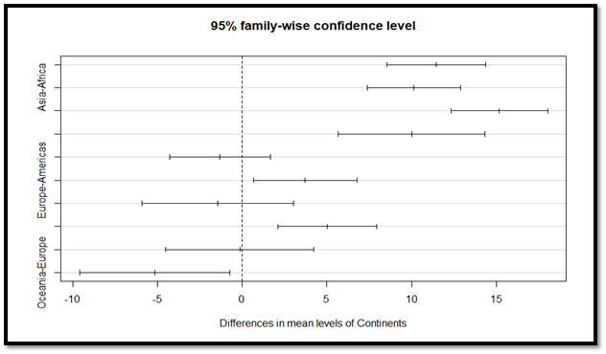
One-way Analysis of Variance (ANOVA)
ANOVA compares all means simultaneously and maintains the type I error probability at the designated level.
One categorical independent variable (Continents)
One quantitative dependent variable (Life Expectency)
The ANOVA (formula: SP.DYN.LE00.IN ~ Continents) suggests that: - The main effect of Continents is significant and large (F(4, 179) = 61.45, p < .001, 90% CI [0.50, 0.64])
ANOVA will tell you if there are differences among the levels of the independent variable, but not which differences are significant.
Post-hoc testing : TukeyHSD (Tukey’s Honestly-Significant Difference):
The confidence intervals for the pairs of Asia-Americas, Oceania-Americas , Oceania-Asia of means all include zero, which indicates that the differences are not statistically significant.
Notes:
T-test increases the chances of Type-1 error, but Anova overcomes this by comparing all means simultaneously and maintaining type 1 error probability at designated level. We have different continents as our categorical independent variable and Life expectancy as dependent variable. After performing Anova, We see that our p value is less than CI, so we reject the null hypothesis. Anova tell us if there are any differences among the continents but not which continents. So we performed Tukey post hoc test. After performing this test, we got to know there are pairs of 3 continents –Oceania, Asia and America are not statistically significant.

Slide 11
Conclusion
The missing values were removed using multiple imputations.
Multicollinearity was detected between variables, namely, GDP per capita and Mortality Rate (Female) and Mortality Rate.
The feature selection rendered a model with AIC around 859 and containing 11 predictor variables, considered as the best model. However, the model was further defined for predictions taking into account collinearity between few variables, leaving us with nine predictor variables.
The model fit value shows good significance measures and the predictions for eleven countries are obtained.
Three continents – Asia, Oceania and Americas has differences in average life expectancies which are not statistically significant. So, we rejected the null hypothesis which says all populations means are equal.

